Slide 1

Servo-motor control using NI ELVIS Digital Systems Development Board
Hardware-Software Platforms: Project Presentation
DUFRANE Antoine (Antoine.DUFRANE@student.umons.ac.be)
FOTSO Mathieu (Mathieu.FOTSOTAGNE@student.umons.ac.be)
LEGER Louise (Louise.LEGER@student.umons.ac.be)

Slide 2
Contents
Context
Software and Hardware installation
Software to install
Board installation
Tests with the board and LabView
Creating a new project
LED and buttons
Servo-motor
Capacitive touch screen
Software operation

Slide 3
Contents
Context
Software and Hardware installation
Software to install
Board installation
Tests with the board and LabView
Creating a new project
LED and buttons
Servo-motor
Capacitive touch screen
Software operation

Slide 4
Context
This tutorial takes place in the Hardware/Software Platforms lesson in first master in electrical engineering of the Faculty of Engineering of Mons
Goals:
To handle the Digital Systems Development Board of National Instrument and LabView
To control a servo-motor by using different interfaces
To understand the creation of VHDL code
In addition to this tutorial, a written report was created as well as a video presentation. Both can be found on GitHub.

Slide 5
Contents
Context
Software and Hardware installation
Software to install
Board installation
Tests with the board and LabView
Creating a new project
LED and buttons
Servo-motor
Capacitive touch screen
Software operation

Slide 6
Software to install
LabView 2018
http://www.ni.com/download/labview-development-system-2018/7407/en/
LabVIEW FPGA Module 2018
http://www.ni.com/download/labview-fpga-module-2018/7351/en/
LabVIEW 2018 FPGA Module Xilinx Tools
http://www.ni.com/download/labview-fpga-module-2018/7353/en/
DSDB Driver
http://www.ni.com/download/digital-systems-development-board-driver-for-labview-2018/7441/en/

Slide 7
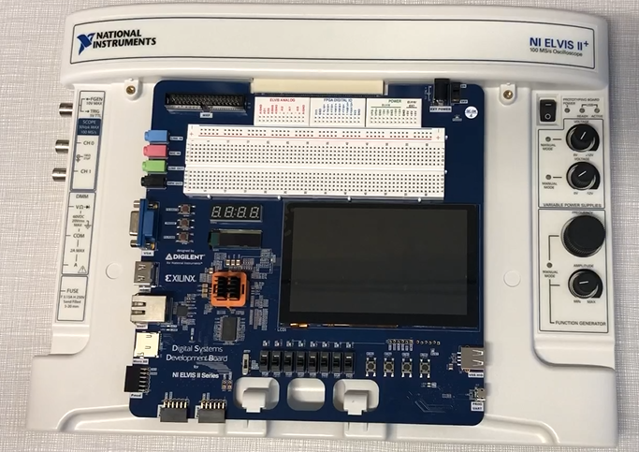
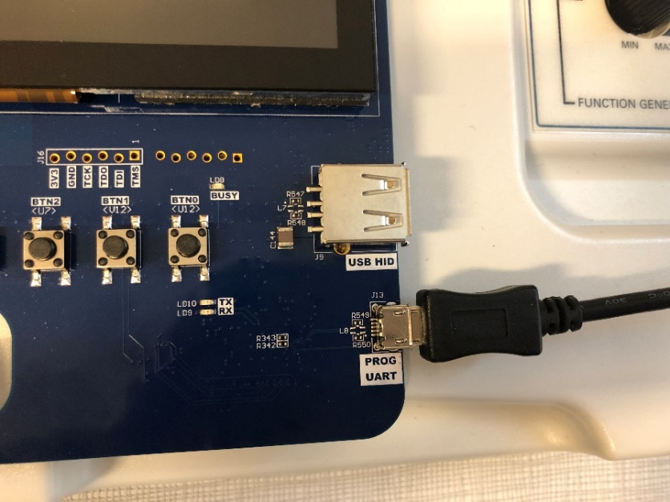
DSDB installation
Insert the DSDB Board into the NI Elvis Board
Plug the board
Connect the NI Elvis Board to the power supply
Connect the UART port to the computer

Slide 8
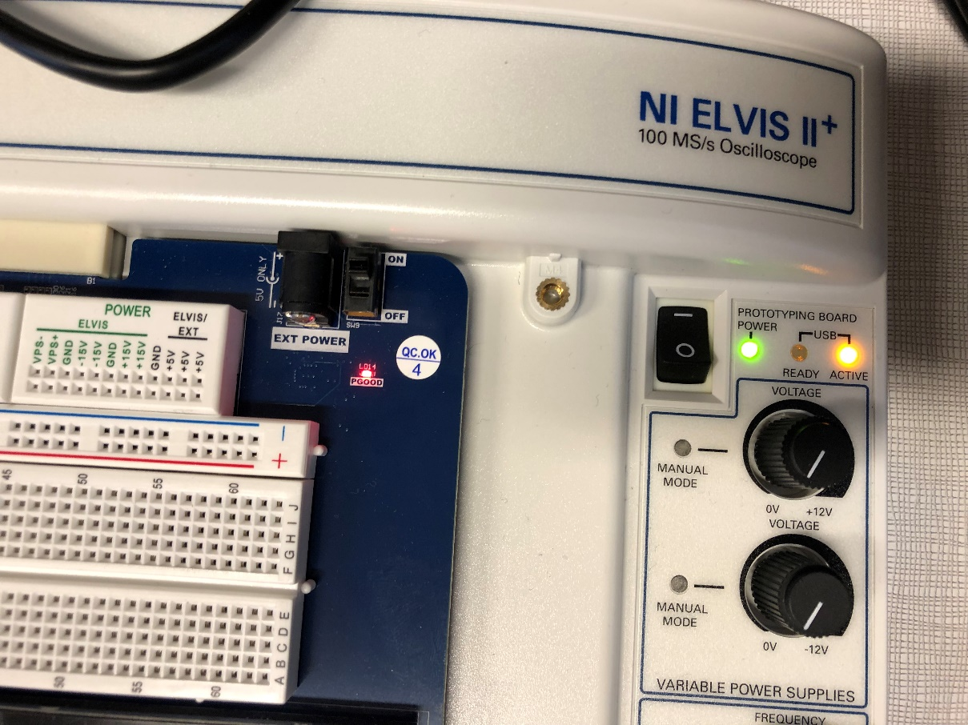
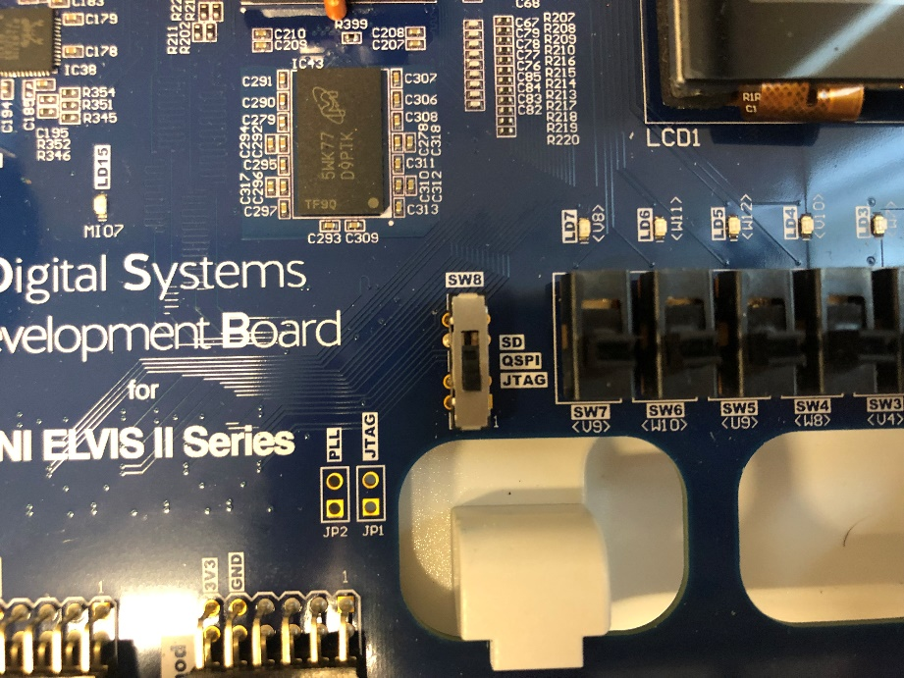
DSDB installation
LED “power”, “active” “PGOOD” should be on when plugging the board
Check that the JTAG position is selected
SD: code is written on an external SD card
QSPI: code is written on the memory of the board
JTAG: code is written on the volatile memory of the board

Slide 9
Contents
Context
Software and Hardware installation
Software to install
Board installation
Tests with the board and LabView
Creating a new project
LED and buttons
Servo-motor
Capacitive touch screen
Software operation

Slide 10
Create a new project on LabView
Open LabView 2018
Click on “Create a project”
A new window will open
Click on “empty project” then “finish”
A window “project explorer” will open
Right click on “work station”
New
Targets and peripherals
A window “Add targets and peripherals” will open
Tick “new target or new peripheral”
Open “Digilent”
Select “Digital Systems Development Board”
Click on “OK”

Slide 11
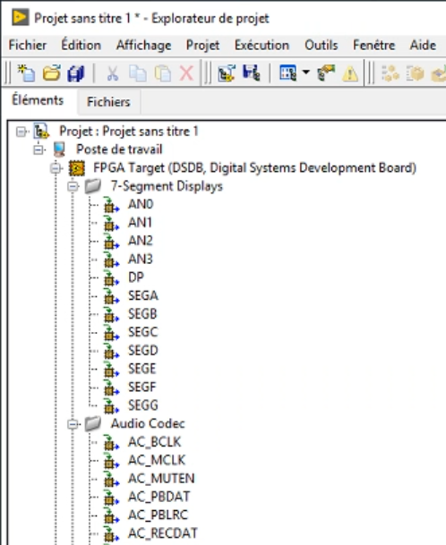
Create a new project on LabView
All ports of the board are now displayed
Right click on “FPGA Target: DSDB,…”
New
VI
Two new windows open
Diagram window: where coding blocs will be positioned
Front-side window: interface with the user

Slide 12
Contents
Context
Software and Hardware installation
Software to install
Board installation
Tests with the board and LabView
Creating a new project
LED and buttons
Servo-motor
Capacitive touch screen
Software operation

Slide 13
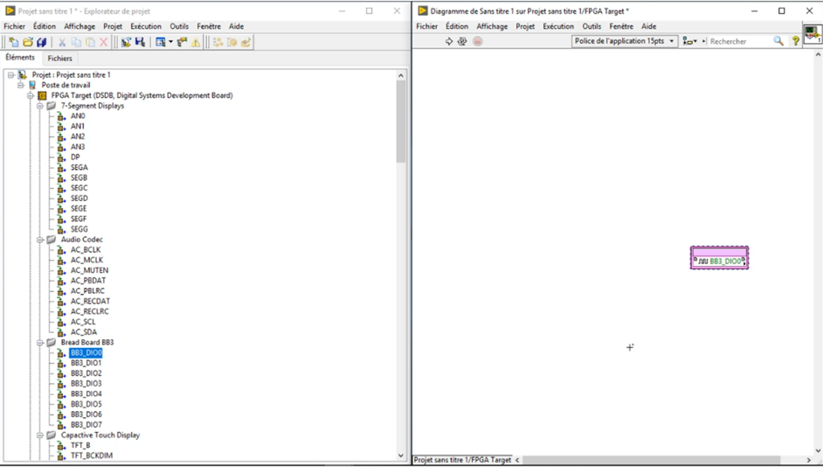
Sending data on a digital port
Slide port “BB3_DiO0” (corresponding to a digital port) from the project explorer window to the diagram window
Note : this port depend on the chosen port for the LED on the board

Slide 14
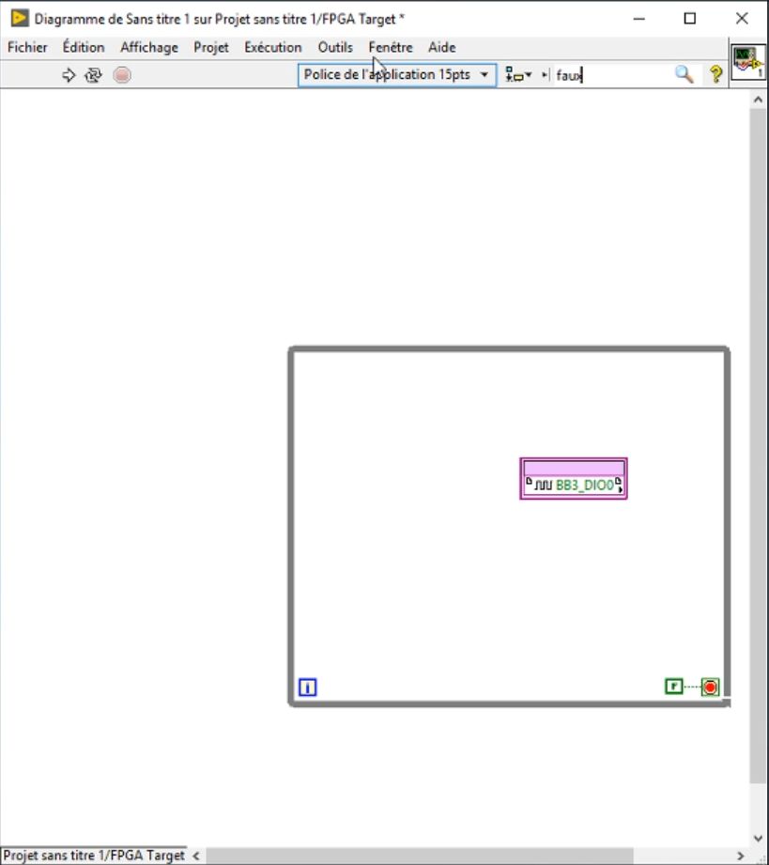
Sending data on a digital port
Add a while loop
Search for “while loop” on the research bar
Make a square, creating a while loop
Add loop stop condition
Search for “false constant”
Connect it to the stop button of the while loop (red button)
That way, the loop will never end

Slide 15
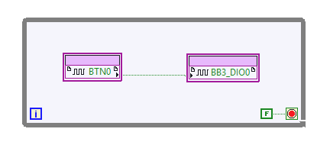
Sending data on a digital port
Slide block “BTN0” from the project explorer window to the diagram window
This block corresponds to the first button on the board
Connect the button to the digital port
Select the output pin of the button and connect it to the input pin of the digital port

Slide 16
Import the code on the board
In the diagram window, click on the white arrow (execute) on the top of the window
Save your project
In the “Select Compile Server” window
Tick “Use the local compile server”
OK
Compilation should be launched. This can take a few minutes

Slide 17
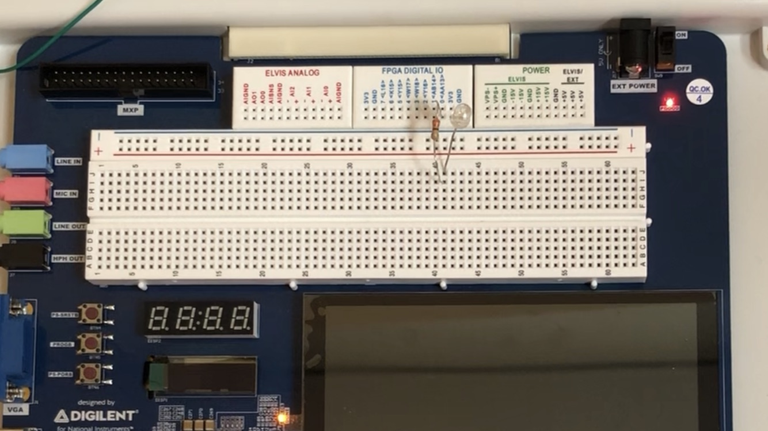
Sending data on a digital port
You can now check the value when the button is pressed with a multimeter between “BB3_DiO0” and “GND”.
Connect a LED in series with a 220Ω resistor between “BB3_DiO0” and “GND”.
The LED should now lights on when the button is pressed.

Slide 18
Contents
Context
Software and Hardware installation
Software to install
Board installation
Tests with the board and LabView
Creating a new project
LED and buttons
Servo-motor
Capacitive touch screen
Software operation

Slide 19
Contents
Tests with the board and LabView
Creating a new project
LED and buttons
Servo-motor
Connection of the servo-motor
Control with user interface on computer
Control with buttons on the board
Capacitive touch screen

Slide 20
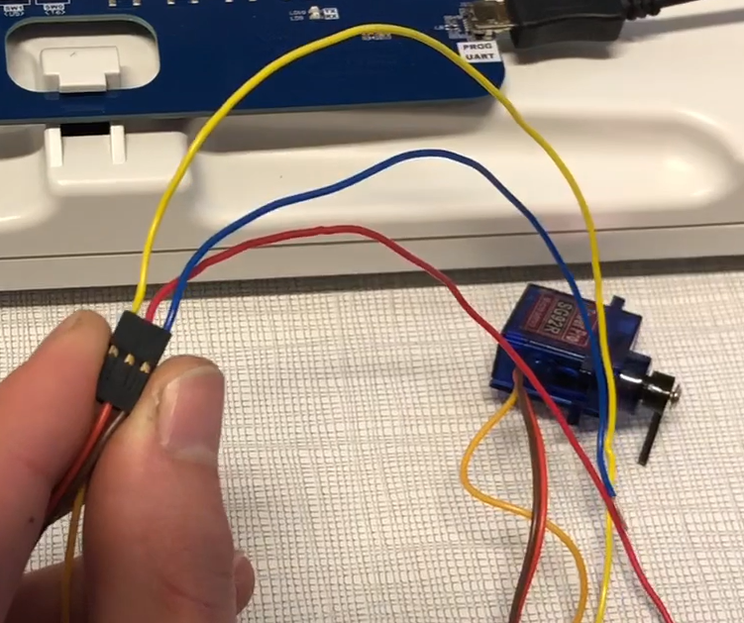
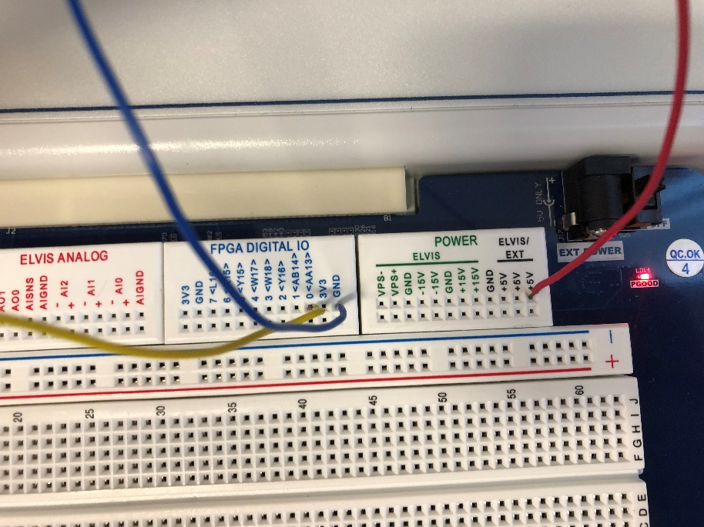
Connection of the servo-motor
One servo-motor and three cables are needed
Connect the cables:
The signal port to a digital port of the board (D0 here)
“+” to 5V on the board
“-” to the ground on the board

Slide 21
Contents
Tests with the board and LabView
Creating a new project
LED and buttons
Servo-motor
Connection of the servo-motor
Control with user interface on computer
Control with buttons on the board
Capacitive touch screen

Slide 22

Programming of the servo-motor
Slide port “BB3_DiO0” from the project explorer window to the diagram window
Note : this port depend on the chosen port for the servo on the board

Slide 23
Programming of the servo-motor
Add a while loop
Search for “while loop” on the research bar
Make a square, creating a while loop
Add loop stop condition
Search for “false constant”
Connect it to the stop button of the while loop (red button)
That way, the loop will never end

Slide 24
Programming of the servo-motor
Add a square wave for the PWM
Right click in the diagram window in order to display functions
Select “FPGA Math & Analysis
Select “ Generation”
Select “Square wave” and slide it in the while loop
Chose properties of the square wave
Chose a frequency of 50 Hz and a Boolean data type

Slide 25
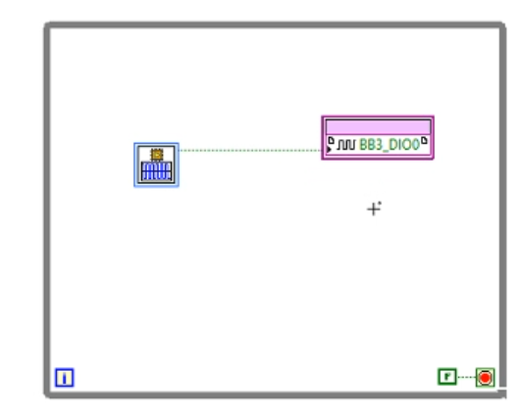
Programming of the servo-motor
Connect the square wave to the digital port
Right click on the digital port, select “change in writing” in order to transform it into an output instead of an input
Select the square wave output port
Connect it to the output pin of the digital port

Slide 26
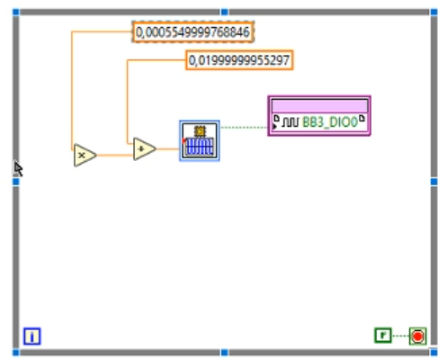
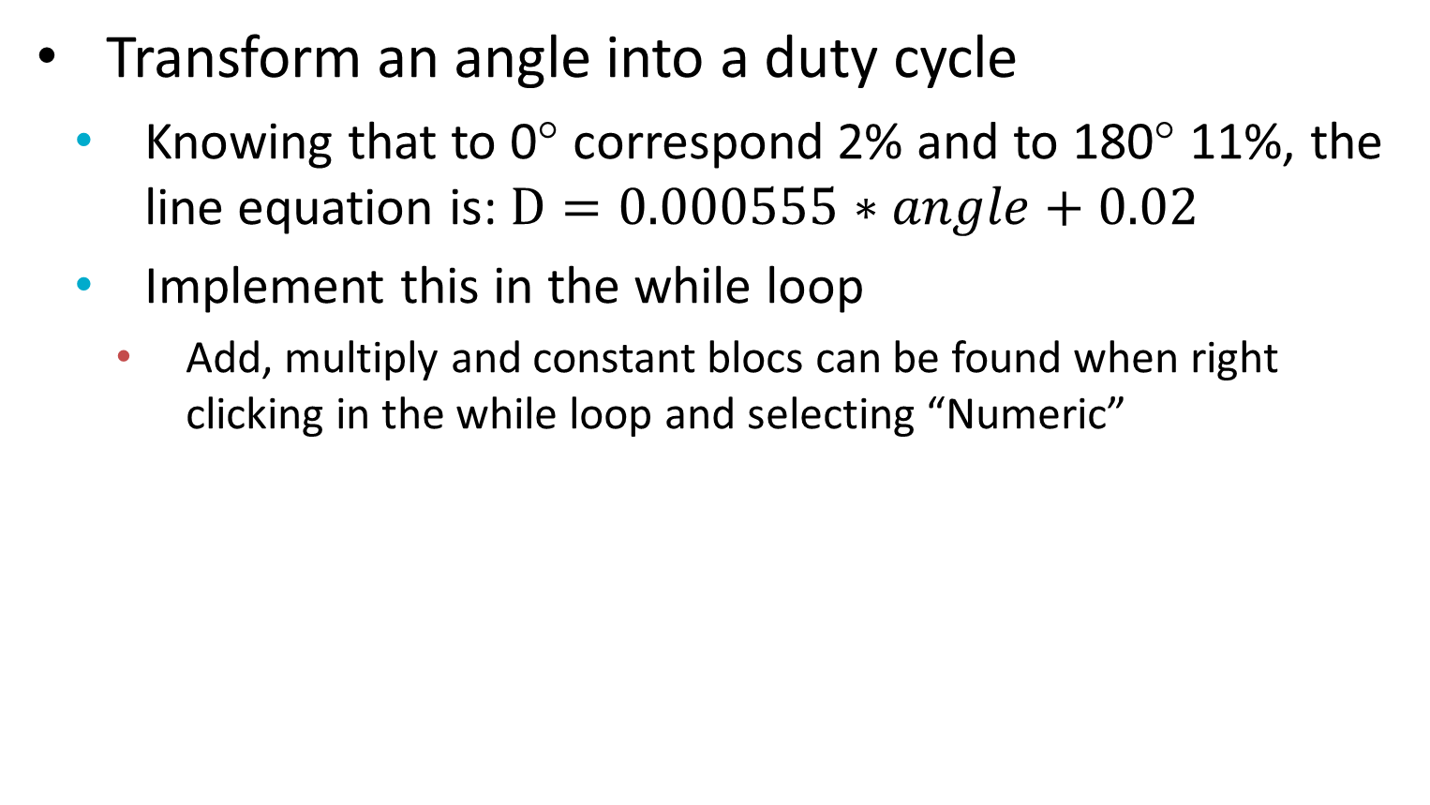
Programming of the servo-motor
Transform an angle into a duty cycle
Knowing that to 0° correspond 2% and to 180° 11%, the line equation is: $D=0.000555∗angle+0.02$
Implement this in the while loop
Add, multiply and constant blocs can be found when right clicking in the while loop and selecting “Numeric”

Slide 27
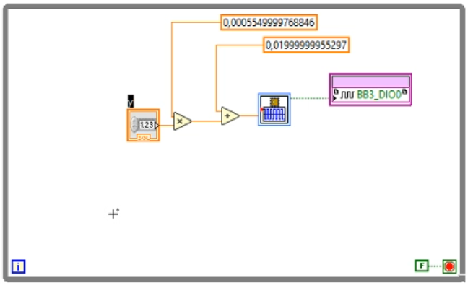
Programming of the servo-motor
Add the angle control
Right click on the last port of the multiply bloc
Select “create”
Select “command”: a bloc should appear

Slide 28
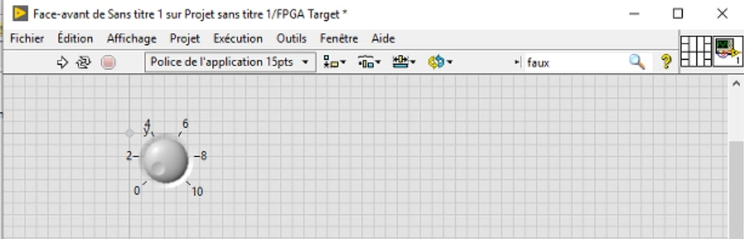
Programming of the servo-motor
Add an interface for the user
Double click on the new bloc: this should open the front-side window
Select the element with “0” and click right
Select “replace”, “Numeric” and finally the kind of interface wanted. Here, a rotating button is chosen.

Slide 29
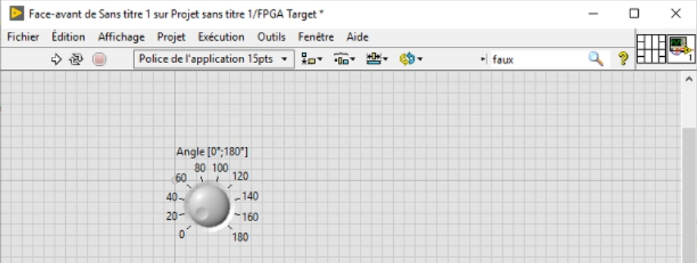
Programming of the servo-motor
Adapt the button to the application
Right click on the button: the properties window opens
In scale: chose 180 for the maximum
Click on “OK”

Slide 30
Contents
Tests with the board and LabView
Creating a new project
LED and buttons
Servo-motor
Connection of the servo-motor
Control with user interface on computer
Control with buttons on the board
Capacitive touch screen

Slide 31
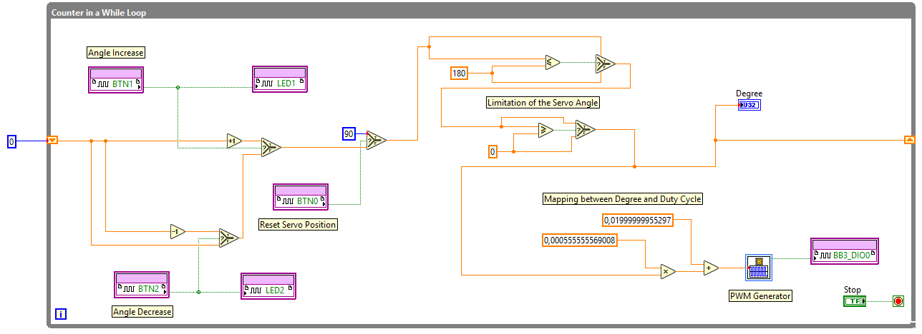
Control of servo-motor angle with buttons on the board
The purpose of this test is to increase and decrease the angle of the servo-motor by pressing buttons on the board, and to display the value of the angle on the computer screen in LabView

Slide 32
Control of servo-motor angle with buttons on the board
1: Previous blocs for PWM
2: Limitation of the mechanical servo position
3: Command of the servo by pressing buttons
3
2
1

Slide 33
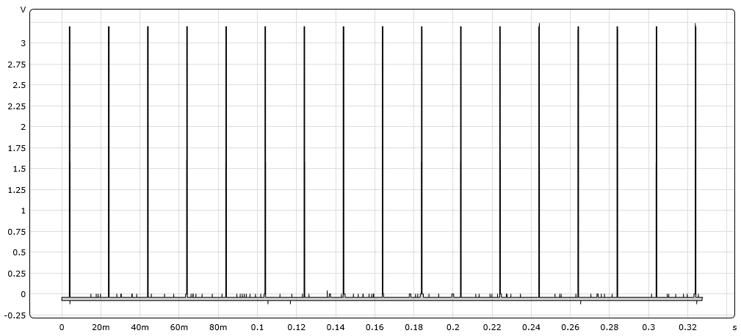
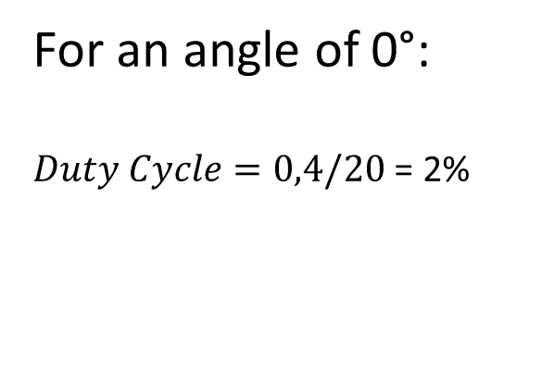
Test bench
This section consists of the verification of the code before
sending data to the servo. The control of the servo is made
by a PWM signal with a Duty Cycle between 2% and 12% at
50Hz.
For an angle of 0°:
$Duty Cycle=0,4/20$ = 2%

Slide 34
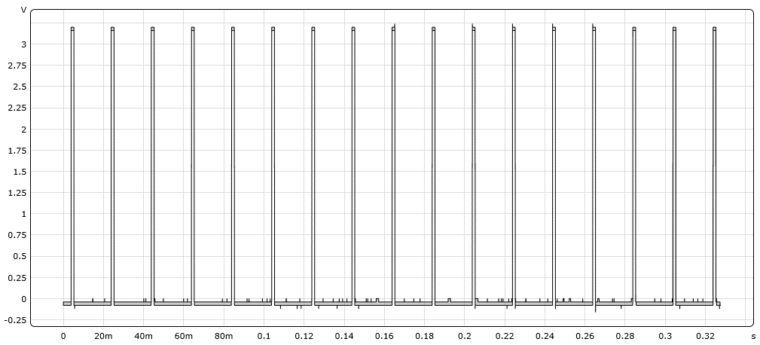
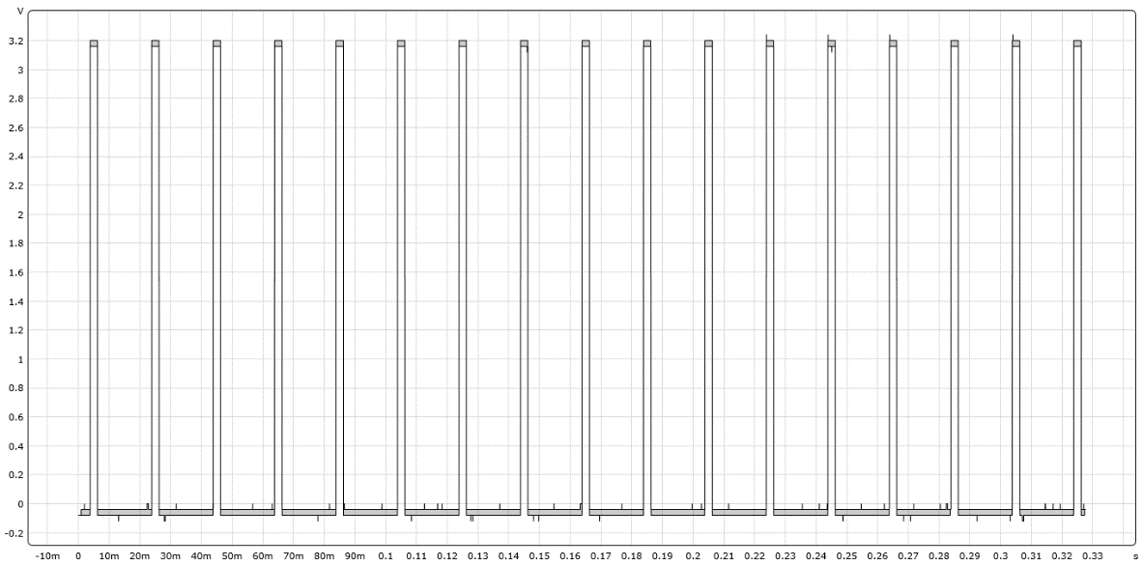

Test bench
For an angle of 90°:
$Duty Cycle=1,4/20$ = 7%
For an angle of 180°:
$Duty Cycle=2,2/20$ = 11%

Slide 35
Contents
Context
Software and Hardware installation
Software to install
Board installation
Tests with the board and LabView
Creating a new project
LED and buttons
Servo-motor
Capacitive touch screen
Software operation

Slide 36
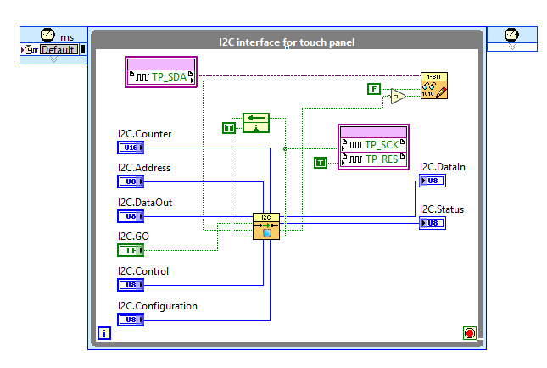
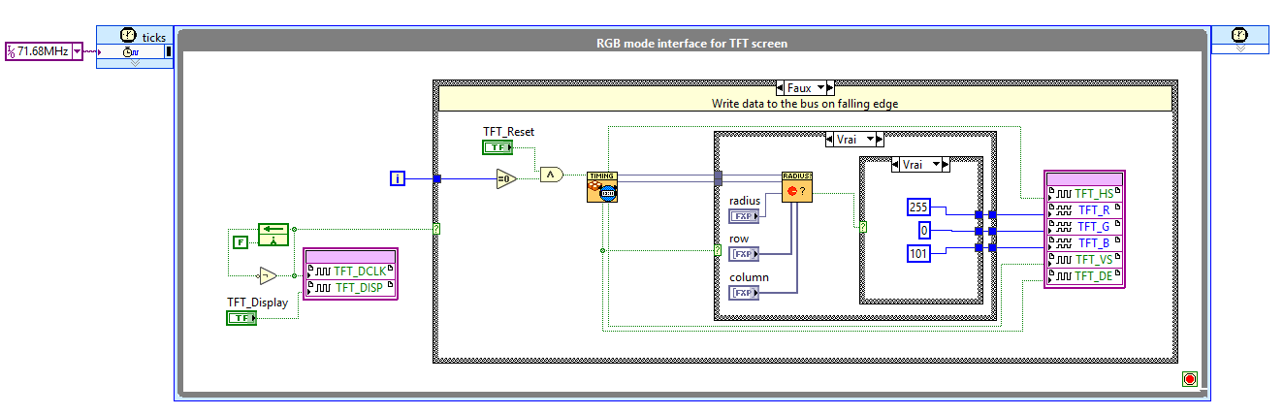
Other examples
Other examples can be found on GitHub. For instance the utilisation of the capacitive touchscreen.
The classical example displays a circle when the screen is touched.

Slide 37
Contents
Context
Software and Hardware installation
Software to install
Board installation
Tests with the board and LabView
Creating a new project
LED and buttons
Servo-motor
Capacitive touch screen
Software operation

Slide 38
How does it work?
LabView generates a report after the compilation
All steps of the compilation can be found in this report
Compiler = Vivado by Xilinx
The programming is made using blocks which are interpreted in a VHDL code
The VHDL pseudo-code of each block is accessible only during the compilation
After this step all files are deleted

Slide 39
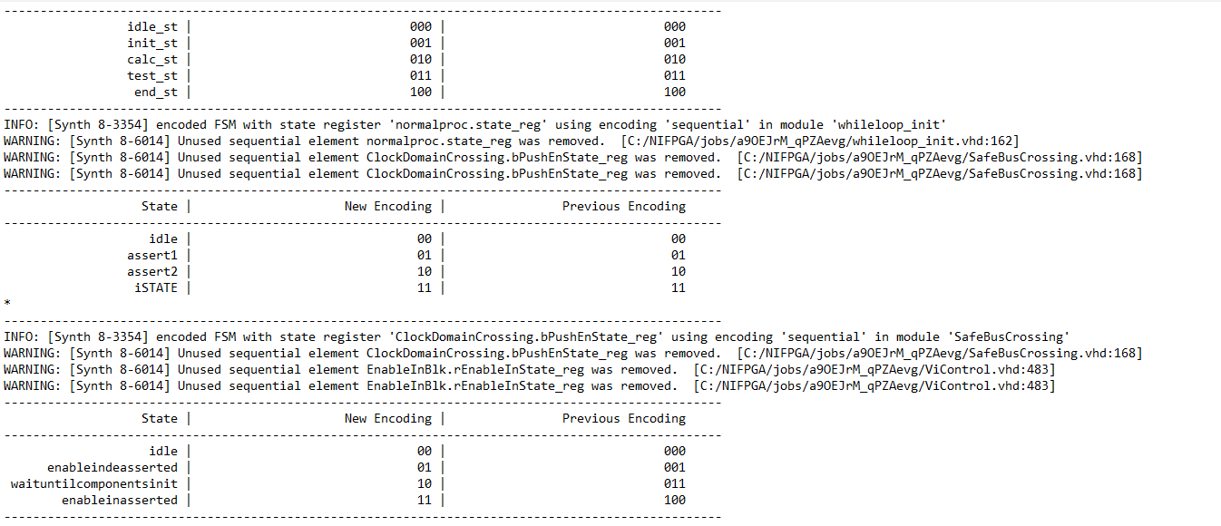
How does it work?
Compilation report
Synthesizing modules, truth table, cell usage, optimization, …

Slide 40
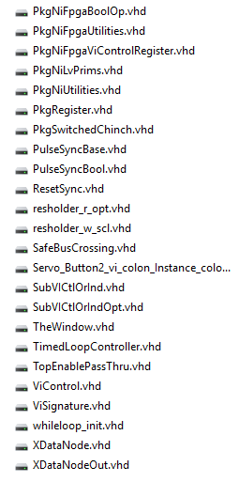
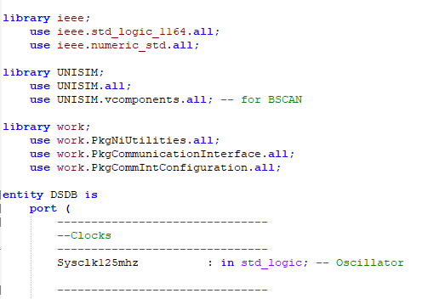
How does it work?
C:\NIFPGA\jobs
VHDL code for synthesizing in LabView

Slide 41
Thanks for your attention !
DUFRANE Antoine (Antoine.DUFRANE@student.umons.ac.be)
FOTSO Mathieu (Mathieu.FOTSOTAGNE@student.umons.ac.be)
LEGER Louise (Louise.LEGER@student.umons.ac.be)

